Slide 1
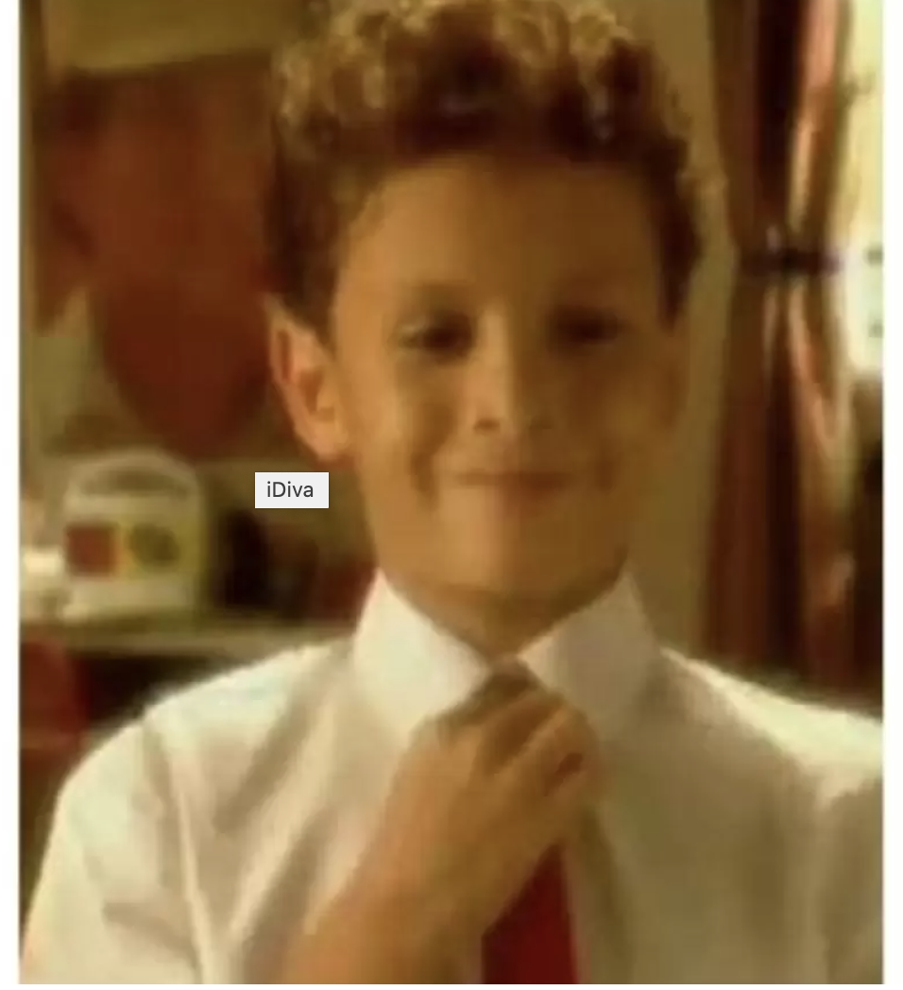
Identify this Brand And Complete jingle
Classwork, homework, punishment, lecture

Slide 2

Identify this Brand using this Audio
Notes:
Kingfisher

Slide 3
Identify this flim studio using audio

Slide 4
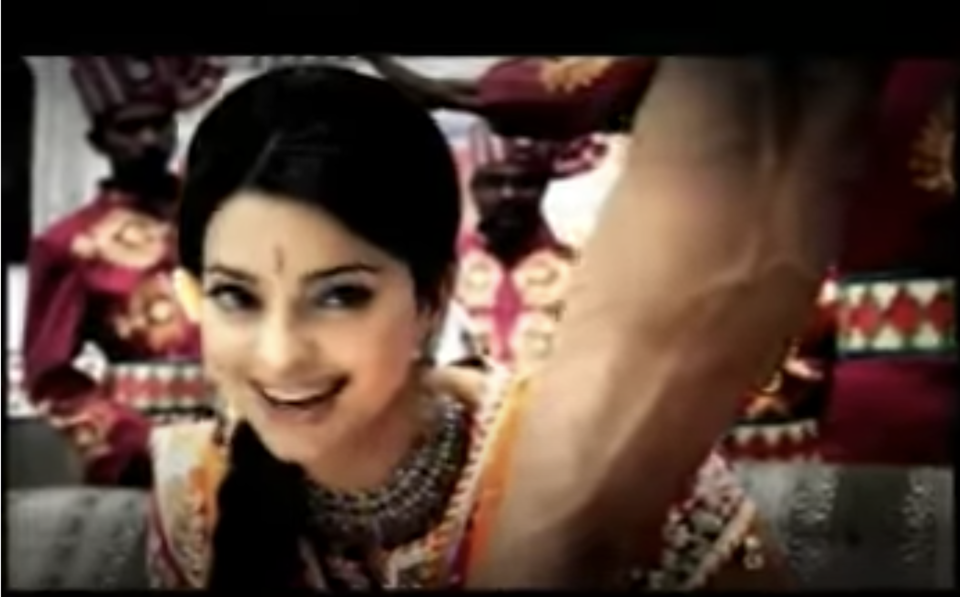
Guess famous Kurkure Tagline
Notes:
Tedha Hai Par Mera Hai

Slide 5
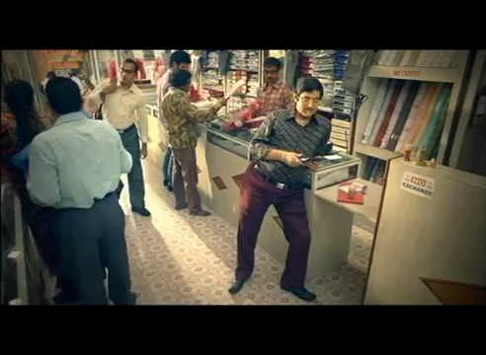
Identify this Brand using this Video
Tell the brand and tag line of this
Notes:
Tata Sky

Slide 6
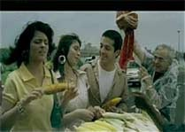
Identify this Brand using this single frame
Notes:
Cholro mint

Slide 7
Identify this Biscuit Brand using this Famous Tagline
Hak se maango

Slide 8
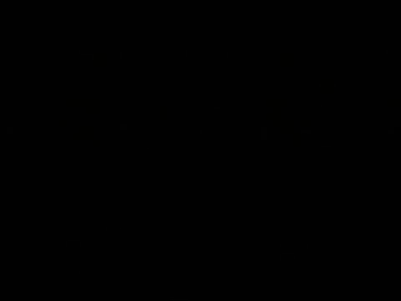
Identify this Soap commercial
Notes:
Nima Sandal

Slide 9
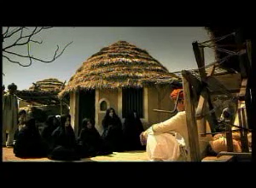
Identify the Brand using this Video
Notes:
Camilin marker

Slide 10
Identify the Brand using this Audio
Notes:
thumbs up

